Slide 1
System Design
Nicholas Mendez

Slide 2
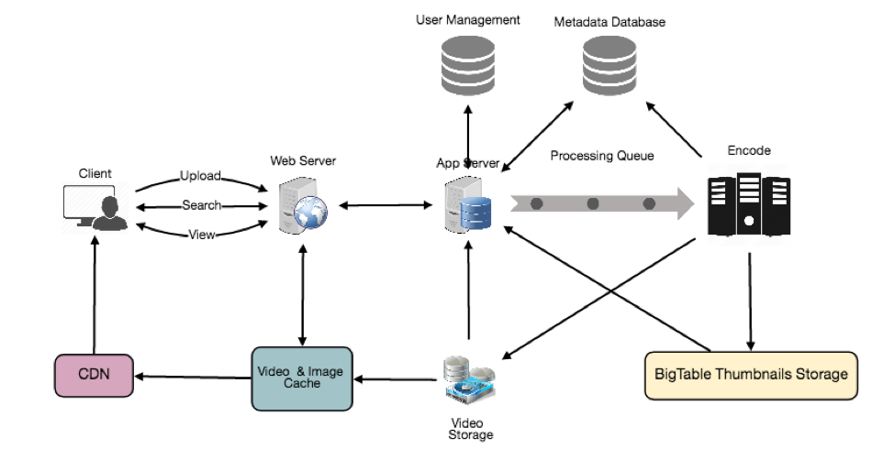
System Design
Process of defining the architecture, modules, interfaces, and data for a system to satisfy specified requirements.
Applies:
Cloud Design Patterns
Distributed System Architectural Patterns
Concepts:
Database replication
Database partitioning
Map Reduce
Microservices
Message Brokers
Queuing
Caching
Event Stream
Load Balancing
Case Study: Tinder

Slide 3
System Components
File Storage: Services for hosting, optimizing and distributing media files
Static Hosting: Github pages, firebase hosting, netlify
Compute:
Cloud Virtual Machine: Eg Digital Ocean Droplets, Google Compute Engine, AWS EC2
App/Container Hosting or Platform as a Service (PaaS): Heroku, KintoHub, Render
VPS/Shared/Managed/Dedicated Hosting
External Systems, 3rd Party APIs/Service: Eg. Google Maps, Facebook API, YouTube API
Databases:
No/SQL: MongoDB, Firebase Firestore/Real Time Database, Harper DB
Relational: PostGres, MySQL, SQL Server, MariaDB
Graph: TigerDB, Neo4j, DGraph

Slide 4
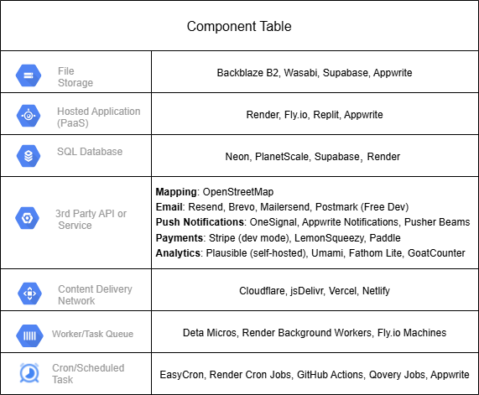
Components of a System

Slide 5
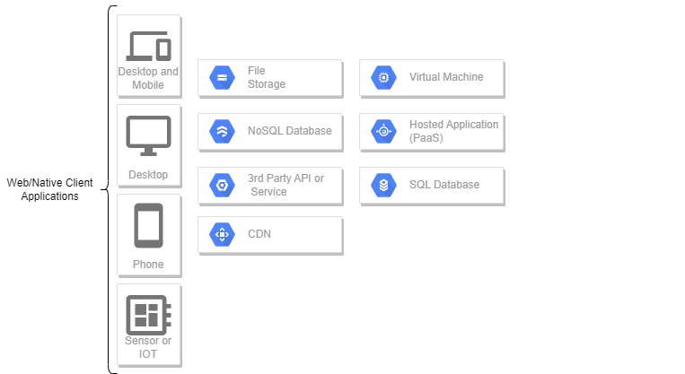
Conventions
Draw.io Template

Slide 6
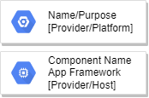
Diagramming guidelines 1
Component Structure
Name/Purpose of component
Type of App eg (react,/svelte/vue/flask/django/express app) (for compute components)
[ Hosting service ]
Do not include any libraries, sdks, sensors that are already part of an existing component
Each component must be a separate device on the network with a unique IP address
Arrows are unidirectional, should indicate which component initiates calls/messages to the other component after it has been loaded
Only compute components can be intermediates between other components

Slide 7


Diagramming guidelines 2 Server - Client-Server Connections
Arrows represent network requests to other components, they can be unidirectional or bidirectional based on the communication protocol.
Protocol | Example
HTTP Request: AJAX or normal web request. Unidirectional and indicates which component initiates calls/messages to the other component after it has been loaded. This is the default protocol and is implied if not specified on the arrow.
HTTP Web Push: Push Notifications, server delivers messages to clients using the Push API.
WebSockets and Web Transport are bidirectional protocols used for real-time delivery.
Server Sent Events is a protocol for servers to deliver real time messages to clients over a keep alive connection.
HTTP
Web Push
Web Socket/Transport
HTTP SSE

Slide 8

Diagramming guidelines 3
Mainly only compute components can be intermediates between other components, eg client -> web app -> database
Protocol | Example
HTTP Request: 3rd party API’s can send web requests to your application via setting up webhooks on the integration. Your server can also receive requests from other servers.
Depending on the database engine, servers connect to databases using the corresponding protocol eg: mysqli://, neo4j://, postgresql://
WEB RTC is a bidirectional peer to peer protocol, commonly used in video calling apps
HTTP
3rd party server
your server
mysql/postgres
Web RTC

Slide 9
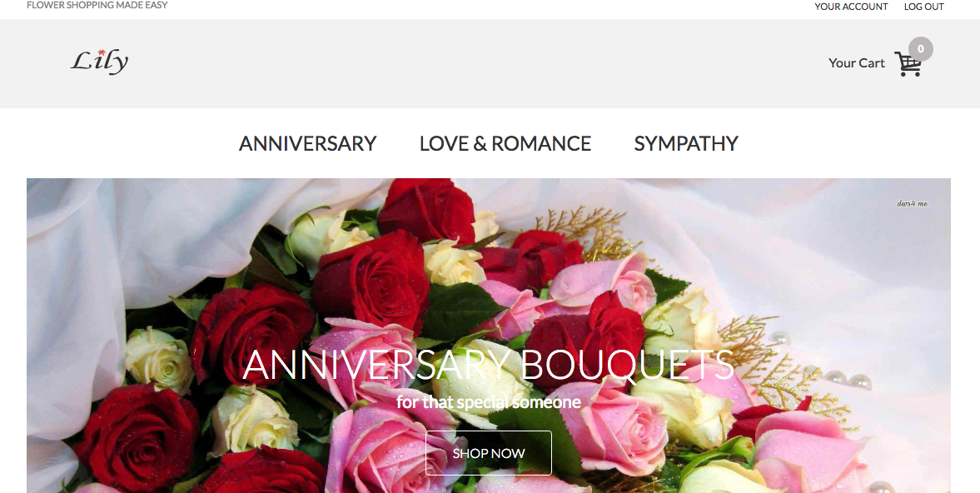
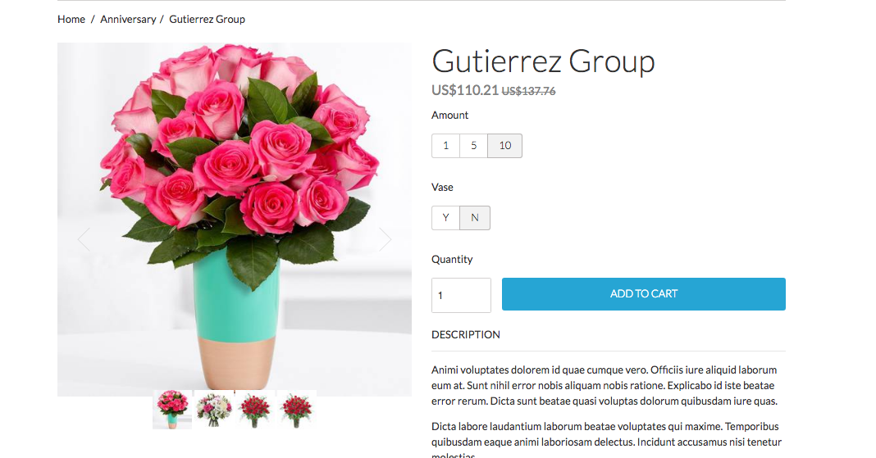
Case Study: lily’s
Lily’s Flower E-commerce Application
Requirements:
Web and Mobile clients
Product browsing
Order fulfillment
Product analytics dashboard
Location Based coupons (mobile only)
Non functional requirements:
High volume real time coupon delivery
Fast read writes of coupon delivery
Coupon delivery service should be independent of web app
Prototype deployment < 1000 users
Testing load < 100 requests per min

Slide 10
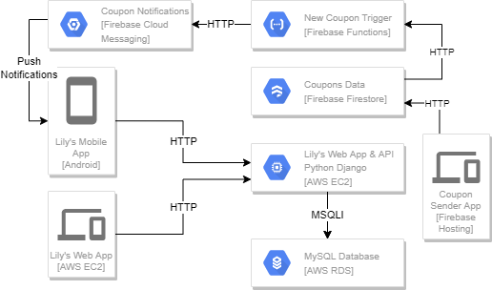
Lily's System Design
Single VM for website and API
Database hosted on separately
Web App and Mobile App REST API on same Virtual Machine
3rd Party service for storing coupons and sending notifications
3 Party service for hosting coupon delivery app

Slide 11
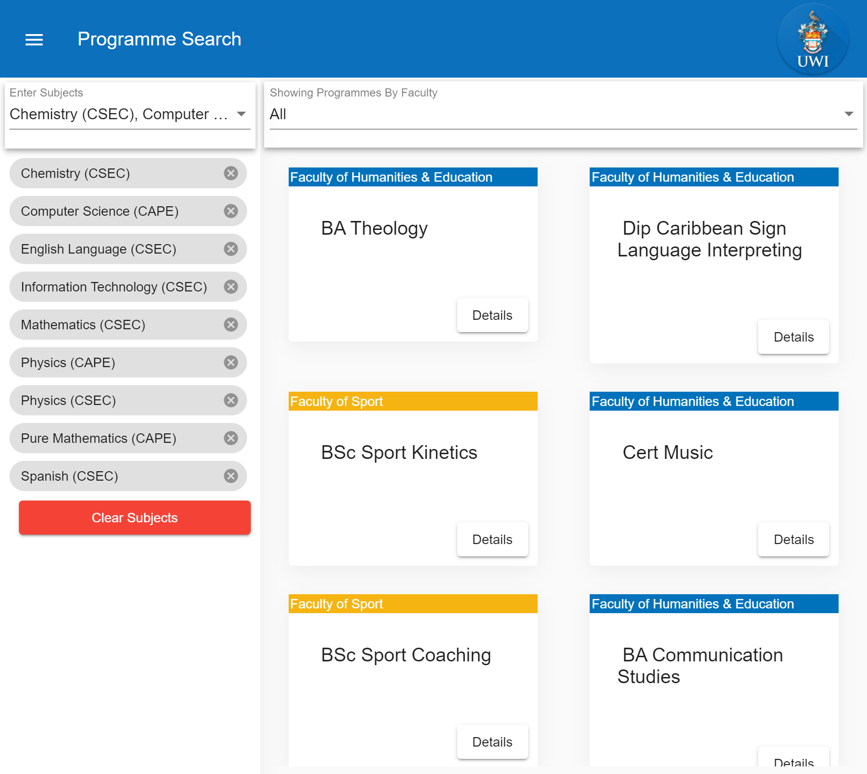
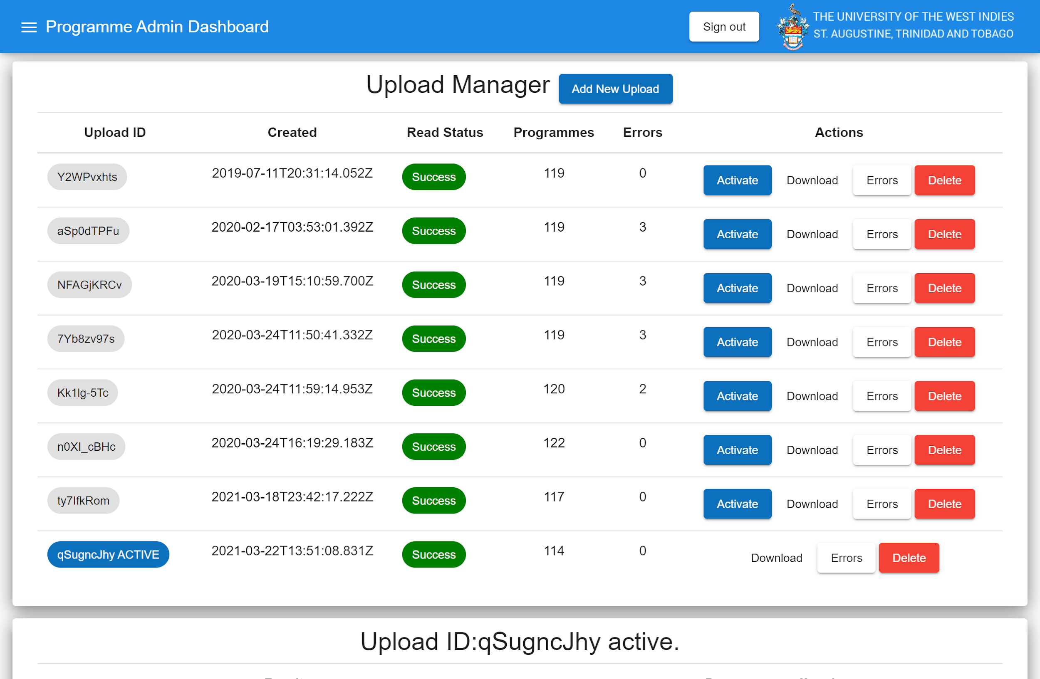
Case Study: BeUWI
Requirements:
Programme Search Client
Browse Programmes
Search programmes by requirements
Programme Admin Client
Upload Programmes via csv files
Manage and rollback uploads
Non functional requirements:
High traffic on Search Client
Requirements Query Time Should be <500ms
Backend Should scale but Database is fixed read only

Slide 12
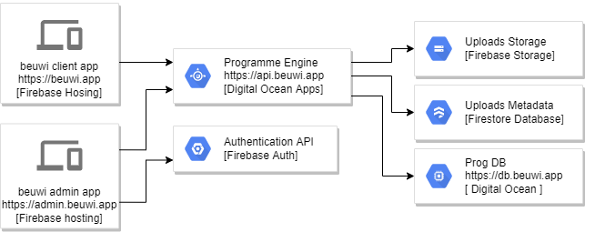
BeUWI System Design
Graph Database used, deployed on dedicated Digital Ocean Droplet (Virtual Machine)
Programme engine deploy on Digitalocean Apps platform for auto scaling and DDoS protection
Stores file uploads separately from backend in firebase storage
Upload metadata stored in NoSQL database, firebase firestore
Admin and Client apps on CDN via firebase hosting
Used firebase auth on admin app

Slide 13
References
10 Common Architectural Patterns
System Design Cheatsheet
CQRS Cloud Design Pattern
Software Architecture | Architectural patterns | Architecture vs Design pattern
Stack Overflow Difference Between Architectural Patterns and Styles
A Complete Survey on Software Architectural Styles and Patterns
Principles of Clean Architecture
Software Architecture: A Case Based Approach
System Architecture
Message Queue vs Pub Sub
Patterns for Software Architectures
PubSub vs Message Queueing
Software Architecture Design
Interactive Architecture Patterns

